Slide 1
Are we set up for financial success?
Lucien H. Fuertes
Bethel School of Technology

Slide 2
Agenda
My Background
Project Introduction
Methods Used
Results
Summary
Conclusions
Questions

Slide 3
Agenda
My Background
Project Introduction
Methods Used
Results
Summary
Conclusions
Questions

Slide 4
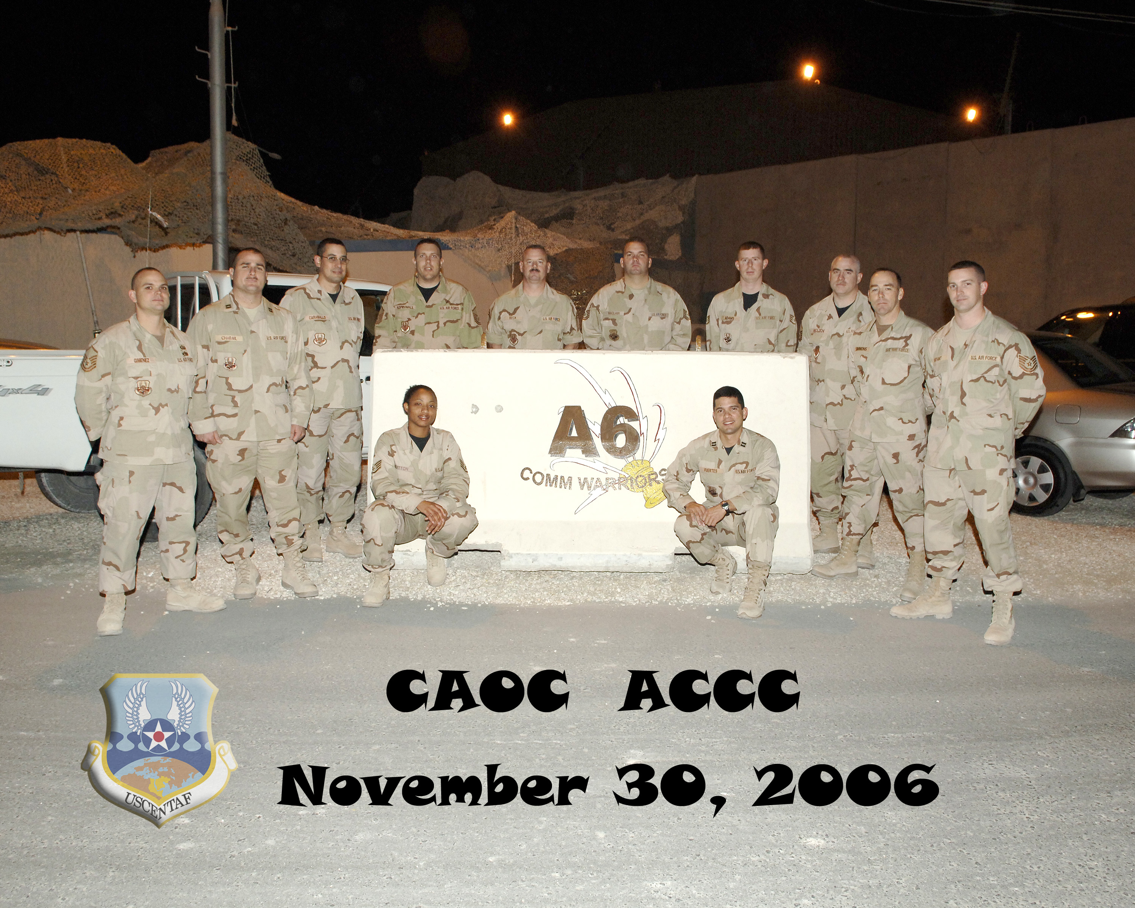




My Background
Previous Education: Computer Science Bachelor’s Degree & MIS
Previous Employment: US Air Force (Active Duty & Civilian)
Current Employment: Software Developer (SQL) – CyraCom International Language Solutions
Other Interests: Personal Finance Coach, Competitive Cyclist, Church Small Groups

Slide 5
Agenda
My Background
Project Introduction
Methods Used
Results
Summary
Conclusions
Questions

Slide 6

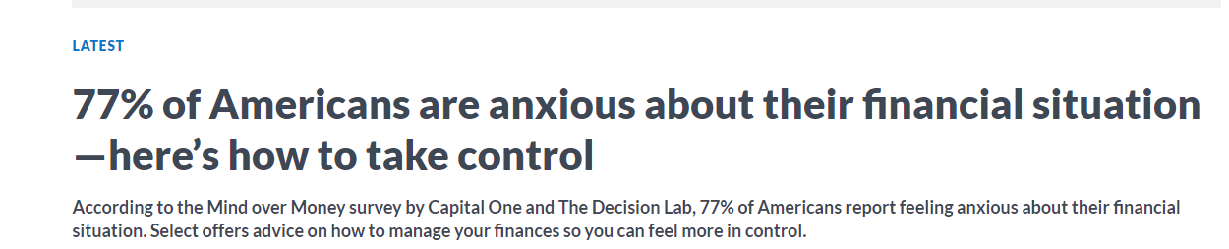
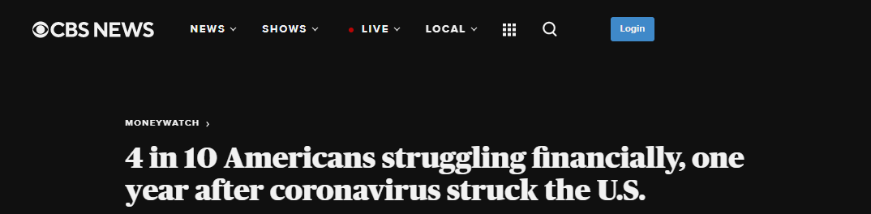
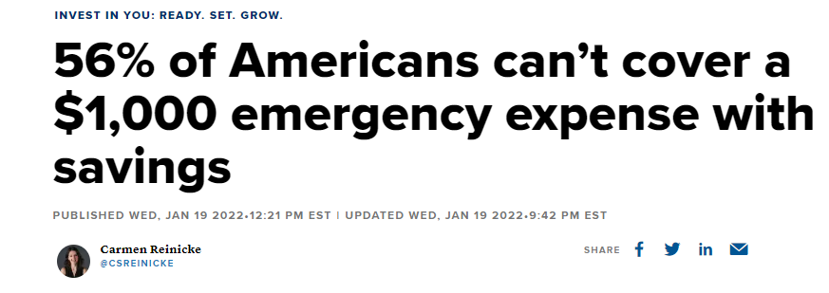
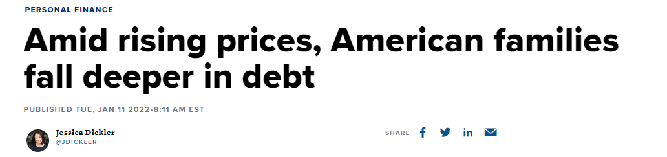
Project Introduction
Today’s Headlines in America

Slide 7
Purpose
Draw insights from the Consumer Financial Protection Bureau’s 2016 Financial Well-being survey
To gain understanding on what behaviors, habits or factors influence a healthy or poor financial well-being
Understand what Financial Well-being is

Slide 8
What is Financial Well-Being?
Financial well-being is a state of being wherein a person can fully meet current and ongoing financial obligations, can feel secure in their financial future and is able to make choices that allow them to enjoy life.

Slide 9
Agenda
My Background
Project Introduction
Methods Used
Results
Summary
Conclusions
Questions

Slide 10
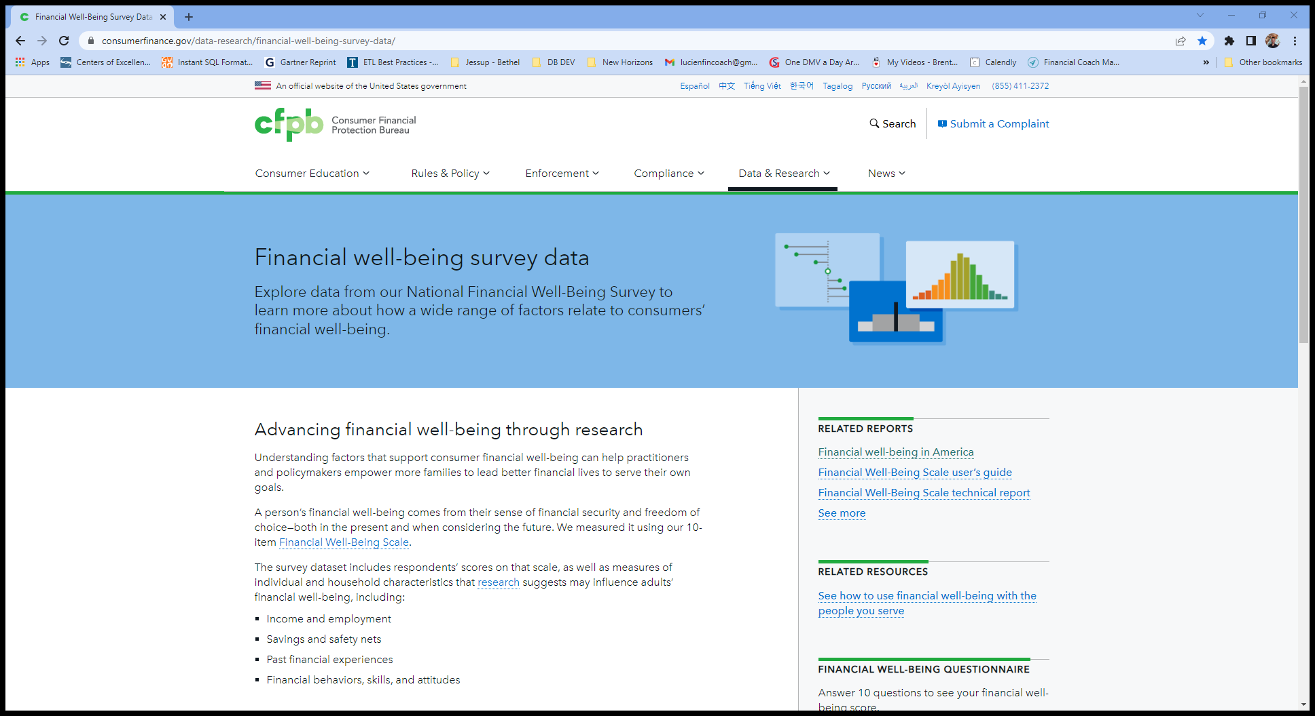
Data
The National Financial Well-Being Survey was conducted in English and Spanish via web mode between October 27, 2016 and December 5, 2016.
Sample size: 6,394
Total Variables: 217
Key variables used:
FWBscore – financial well-being score
FSscore – financial skill score
FS1_7 – can make myself save
SAVINGSRANGES – current money saved
PAREDUC – parent’s highest education
PPINCIMP – participant’s current household income
FINGOALS – has or had financial goals
CHANGEABLE - Belief that ability to manage money is NOT changeable
ABSORBSHOCK - Confidence in ability to raise 2,000 in the next 30 days
SELFCONTROL_3 - I am able to work diligently toward long-term goals
PEM - Everyone has a fair chance at moving up the economic ladder
https://www.consumerfinance.gov/data-research/financial-well-being-survey-data/

Slide 11
Methods Used
Tools
Data Wrangling
RStudio
Jupyter Notebooks
Sub-setting (selecting only the needed variables into a new dataset
Filtering (removing unwanted values like negative values form the dataset)
Removing NA or missing values
Recoding
Variable renaming
Analyses
One-Way Between Subject ANOVA
Independent Chi-Square
Pearson's product-moment correlation
K nearest neighbors prediction

Slide 12
Agenda
My Background
Project Introduction
Methods Used
Results
Summary
Conclusions
Questions

Slide 13
Results
Q1. How does the Financial Skill score correlate to the Financial Well-being score?
Q2. How does FS1_7 "I know how to make myself save" correlate to SAVINGSRANGES “how much money do you have in savings today”?
Q3. How does PAREDUC Influence current income PPINCIMP?
Q4. Is there a difference in PPINCIMP based on whether the participant sets FINGOALS or not?
Q5. Can we predict Financial Well-being Score category (High, Medium or Low) based on the following variables:
CHANGEABLE(ability to manage money not changeable) , ABSORBSHOCK (put together $2K in 30 days), SELFCONTROL_3 (able to maintain long term goals), PEM(everyone can move up the economic ladder), PPEDUC (participants education level)

Slide 14
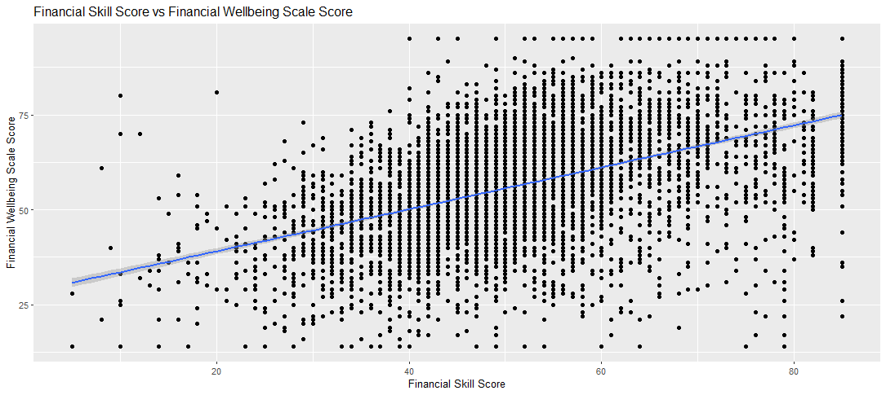
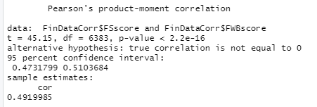

Q1. How does the Financial Skill score correlate to the Financial Well-being score?
Correlation:
49% - Medium

Slide 15
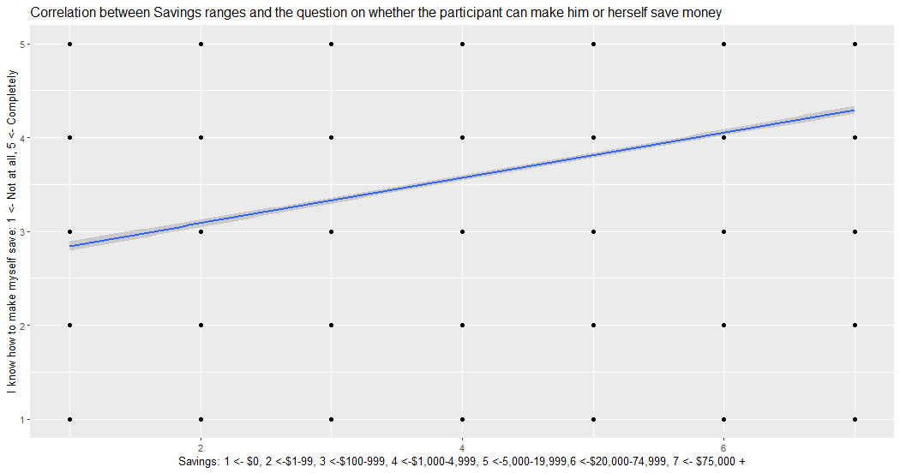
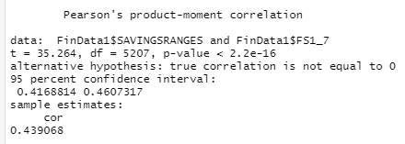

Q2. How does FS1_7 "I know how to make myself save" correlate to SAVINGSRANGES “how much money do you have in savings today”?
Correlation:
44% - Medium

Slide 16
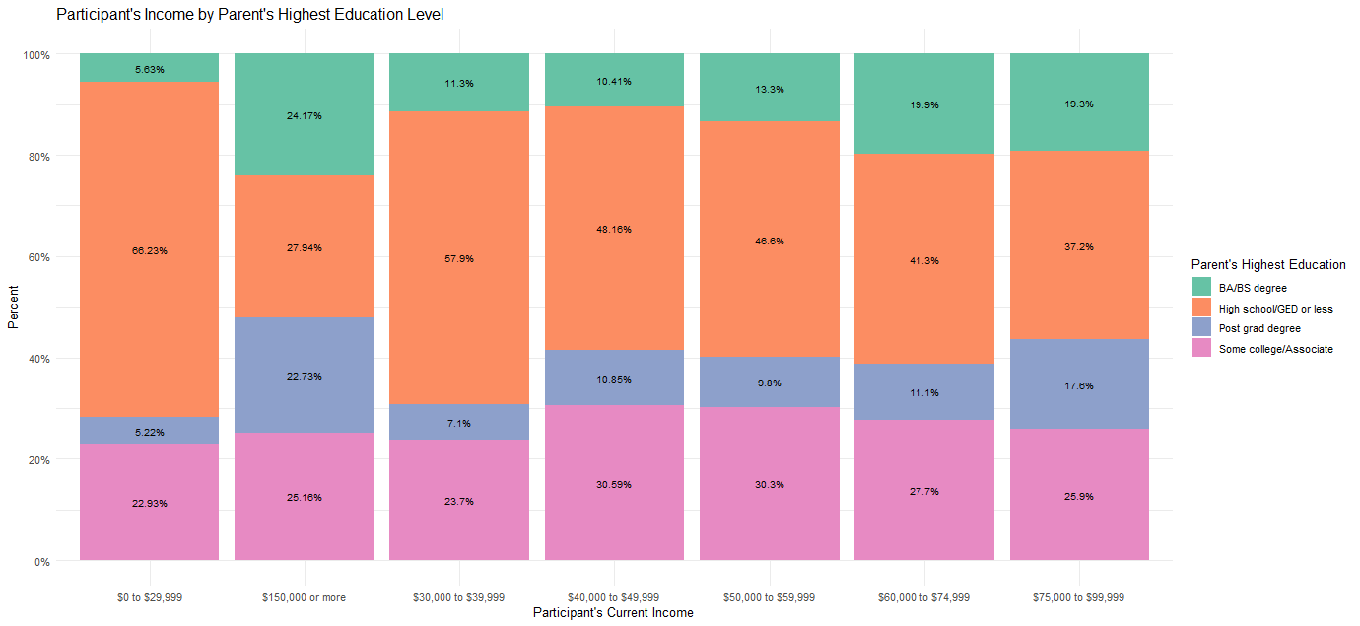
Q3. How does PAREDUC Influence current income PPINCIMP?

Slide 17
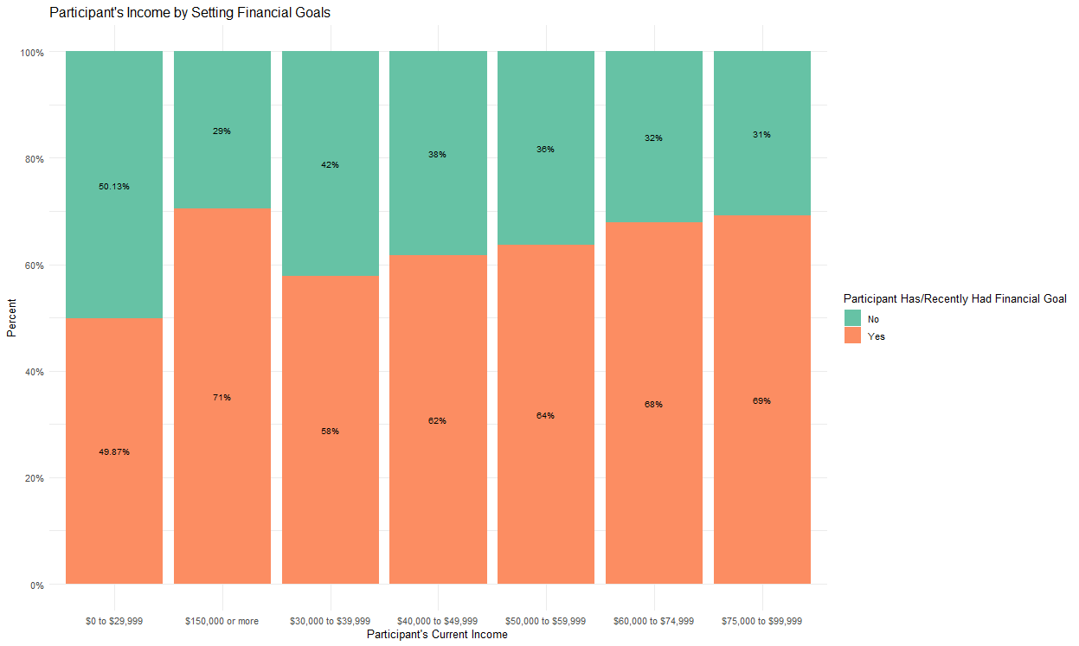
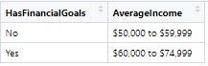
Q4. Is there a difference in PPINCIMP based on whether the participant sets FINGOALS or not?
One-Way Between Subject ANOVA
P values = 2e-16

Slide 18
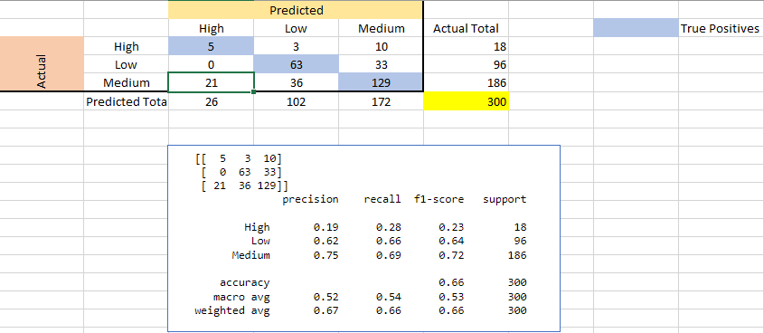
Q5. Can we predict Financial Well-being Score category ( High, Medium or Low) based on the following variables:
CHANGEABLE - Belief that ability to manage money is NOT changeable
ABSORBSHOCK - Confidence in ability to raise 2,000 in the next 30 days
SELFCONTROL_3 - I am able to work diligently toward long-term goals
PEM - Everyone has a fair chance at moving up the economic ladder
PPEDUC - Education (Highest Degree Received)
K nearest neighbors analysis with k = 1

Slide 19
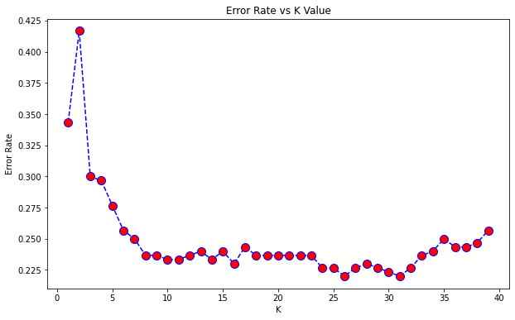


Q6 Calculating the error rate to find the best model
Ran iterations to find the best model
The lowest error rate is for k values of 26 and 31 – error rate of 22%
The original k = 1 value has an error rate of 42%

Slide 20
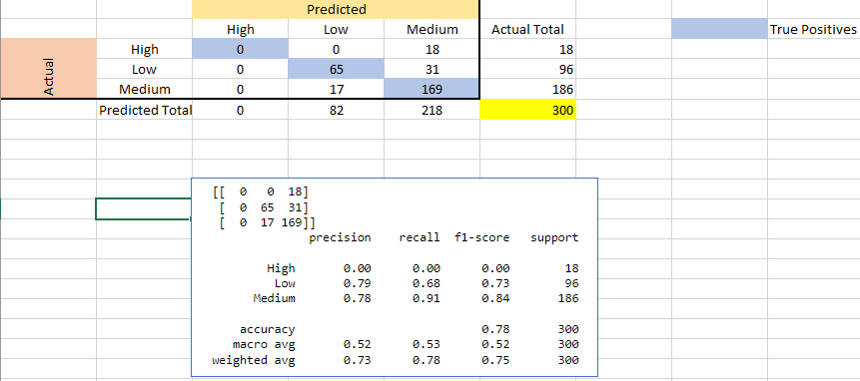
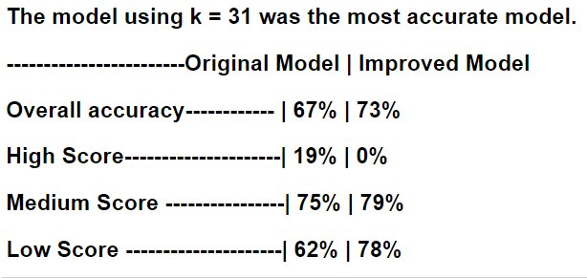
Q6 K nearest neighbors with K = 31
K nearest neighbors analysis with k = 31

Slide 21
Agenda
My Background
Project Introduction
Methods Used
Results
Summary
Conclusions
Questions

Slide 22
Summary
Q1 positive correlation (49%) between the Financial Well-being score and the Financial skill score
Q2 positive correlation (44%) between the variable “I know how to make myself save” and the current savings of the participant
Q3 the higher the level of education of the parents, the higher the participant’s income and vice-versa
Q4 the higher the participant’s income, the higher the percent that sets financial goals
Q6 ML model is 73% accurate when predicting the Financial Well-being score

Slide 23
Agenda
My Background
Project Introduction
Methods Used
Results
Summary
Conclusions
Questions

Slide 24
Conclusions
Q1. The way people perceive their financial situation and outlook matches the financial knowledge they currently posses.
Q2. When people know they can make themselves save, they do.
Q3. The higher the parents education level, the higher the participant’s household income.
Q4. Setting financial goals seem to lead to higher income
Q5. Predicting the Financial Wellbeing score using ML with the chosen variables is not that accurate (73% accuracy).

Slide 25
Agenda
My Background
Project Introduction
Methods Used
Results
Summary
Conclusions
Questions

Slide 26
Questions?

